Slide 1

Salary Survey Analysis
By
Jayanthar S
DADS July Cohort - B

Slide 2

Cleaning Process
Replacing
Replacing null values
Removing
Removing duplicates
Correcting
Correcting data types
Removing
Removing outliers
Placing
Placing the proper currencies symbols

Slide 3
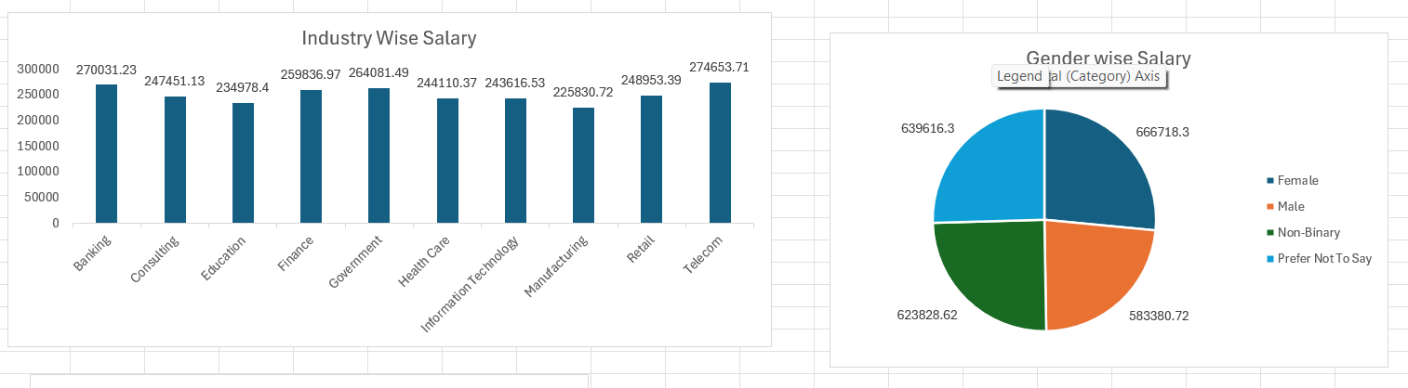
Industry & Gender wise Salary

Slide 4
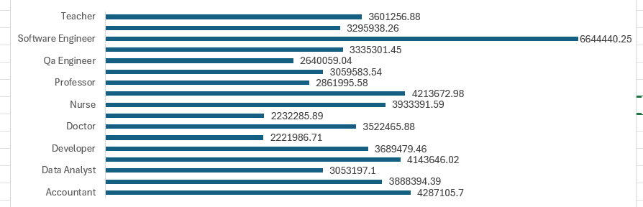
Job Title wise Salary

Slide 5
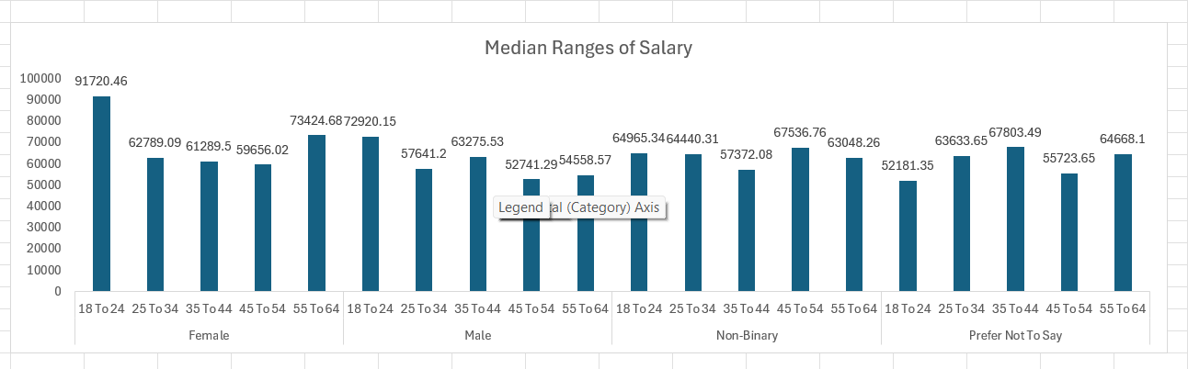
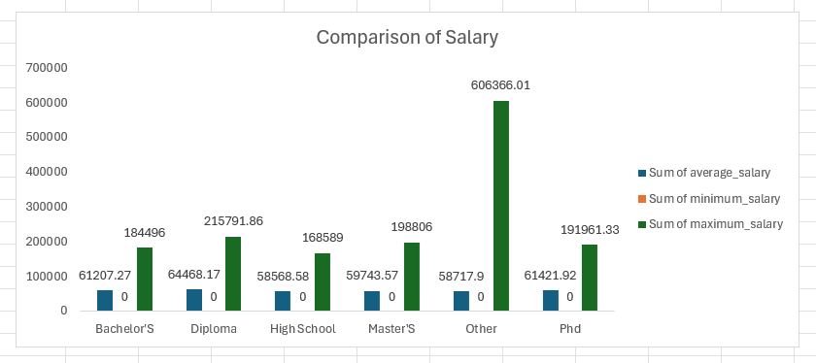
Comparison & Median of Salary

Slide 6
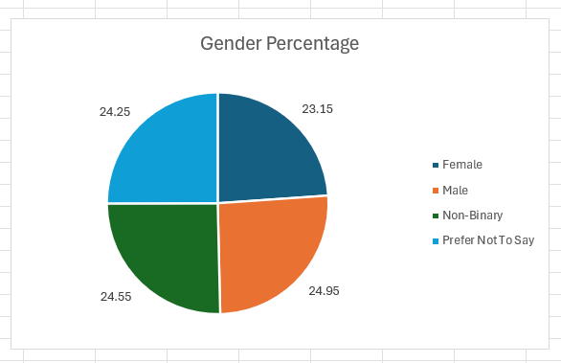
Percentage of Gender

Slide 7
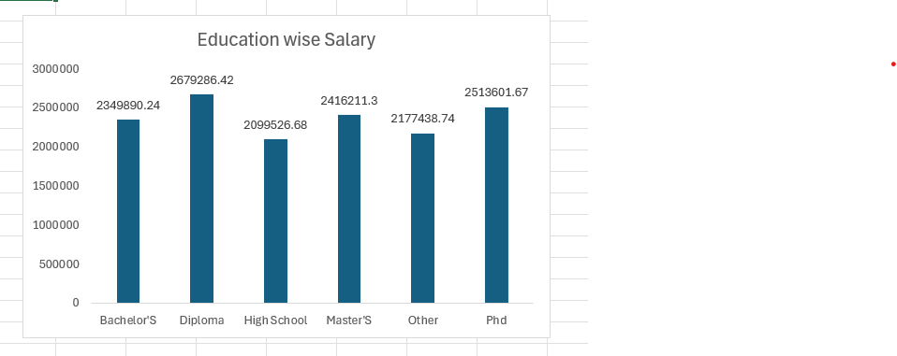
Education wise Salary

Slide 8
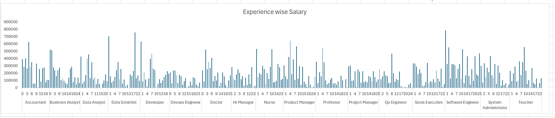
Experience wise Salary

Slide 9
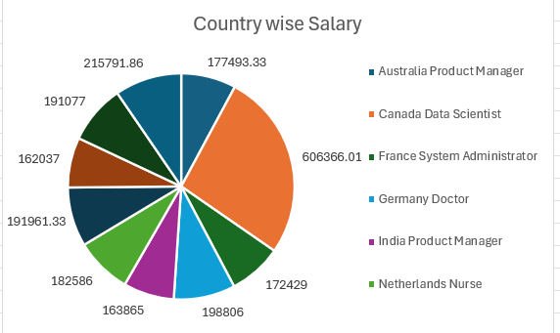
Country wise Salary

Slide 10
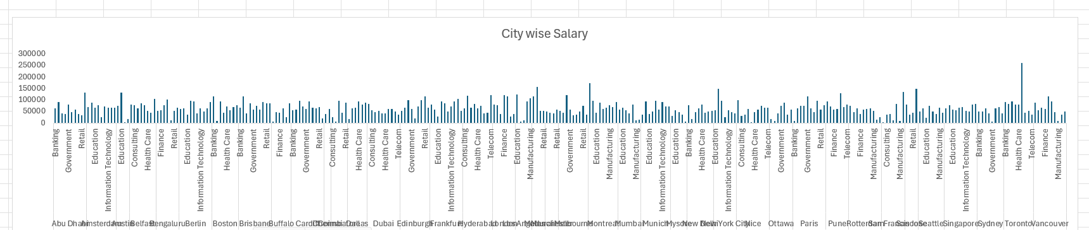
City wise Salary

Slide 11
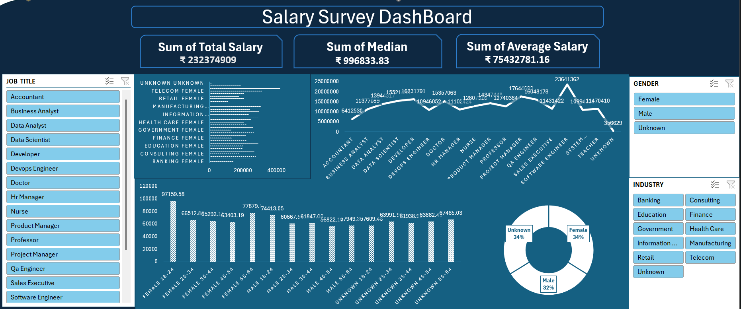
Dashboard

